Slide 1
The Effect of Working Memory Training on Cognitive Control and Reading Comprehension
Jean-paul Snijder

Slide 2
Working Memory Training
A stable trait? Training increased WMC (e.g., Klingberg et al., 2005)
WM Training became popular
Cogmed
Lumosity
Height of Popularity: Jaeggi et al., 2008
“Training on a demanding WM task improved fluid intelligence [(Gf)]”

Slide 3
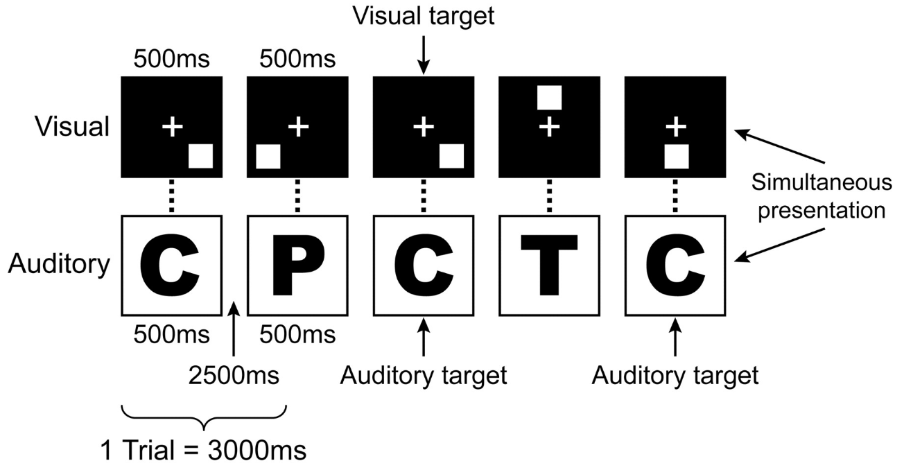
Jaeggi et al., 2008
Trained on Dual 2-back task, transferred to Gf (RAPM)

Slide 4
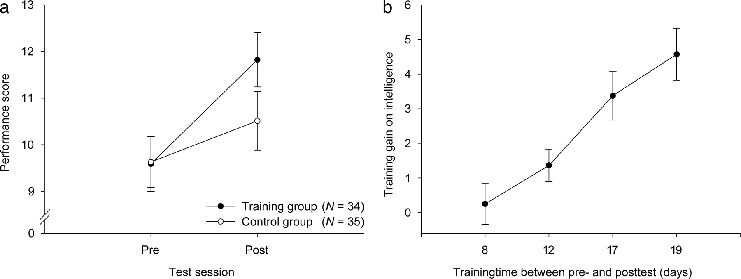
Jaeggi et al., 2008: Results
Gained much attention and replication studies … however

Slide 5
Skepticism and Current Study
Concerns have surfaced over the methodology
Training that targets STM instead of WM
Control group problems
Single test measurement of target cognitive ability
Strategies artificially inflate measurement scores
How these concerns are addressed in the current study
Employing complex working memory span tasks
Novel active control group structure
Multiple measures of cognitive ability
Adaptive and a two-domain training task (e.g., verbal and spatial)
Jaeggi et al., 2008

Slide 6
Method: Groups
Subjects randomly assigned into 3 groups
Experimental group: Cross-training (verbal & spatial)
Chein and Morrison, 2010
2nd: Verbal training only
3rd: Spatial training only

Slide 7
Method: General
Pre-test – Training – Post-test
Native English speakers between 18 – 35
20-day training, over 4 weeks, 30 minutes per session
No more than 1 week between training and post-test
Cognitive ability measurement: Alternate versions at post-test compared to pre-test

Slide 8
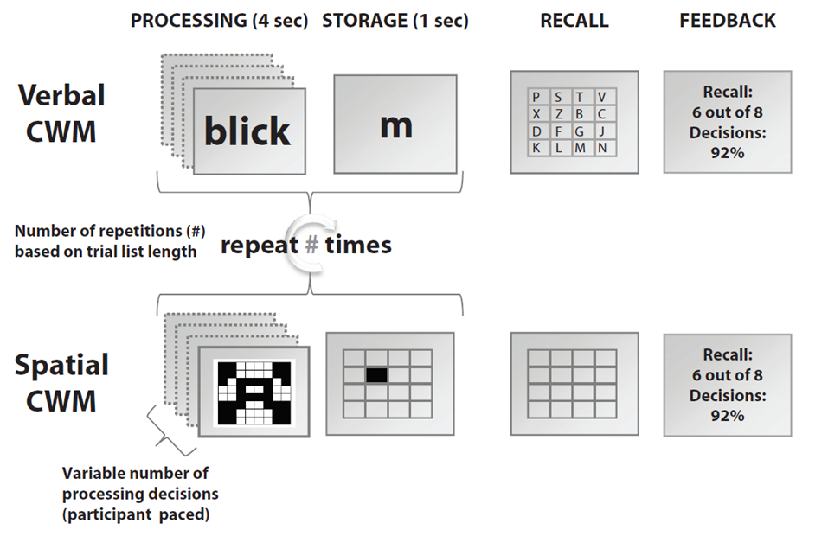


Method: Training
Training paradigm: two domains
Glance
Look
Gaze
Reprinted from Chein & Morrison, 2010

Slide 9
Method: Training
Training paradigm: two domains
Reprinted from Chein & Morrison, 2010

Slide 10
Method: Cognitive Assessments
Measured at Pre-test – Post-test
Cognitive Control (near transfer):
AX-CPT
Stroop
Reading Comprehension (far transfer):
Nelson Denny Reading Test
GRE passages selection

Slide 11
Hypotheses
Performance on training task will improve as subjects progress
All groups will improve on target cognitive abilities
Improvement in reading comprehension will be correlated with improvement in cognitive control
Cross-training group will show stronger improvements in cognitive abilities compared to single task groups

Slide 12
Results
Gathering subjects was more difficult than expected
To date:
60 subjects completed pre-test
51 started the training
21 completed post-test (e.g., entire experiment)
Lack of power; combined cross-training and single task groups
The last hypothesis (Single task=↑; Cross-training =↑↑) was dropped from analysis

Slide 13
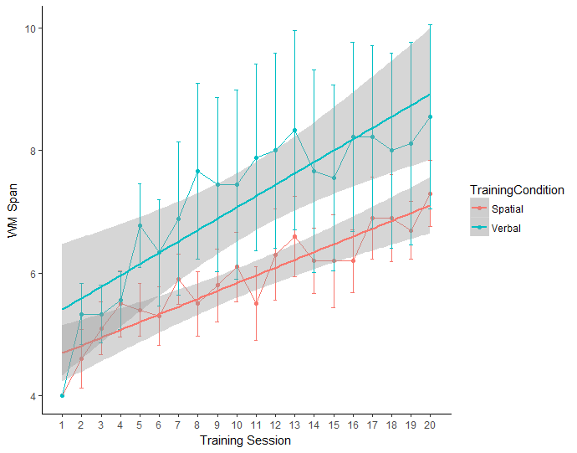
Result 1: Training Improved WMC
Verbal Training
Spatial Training

Slide 14
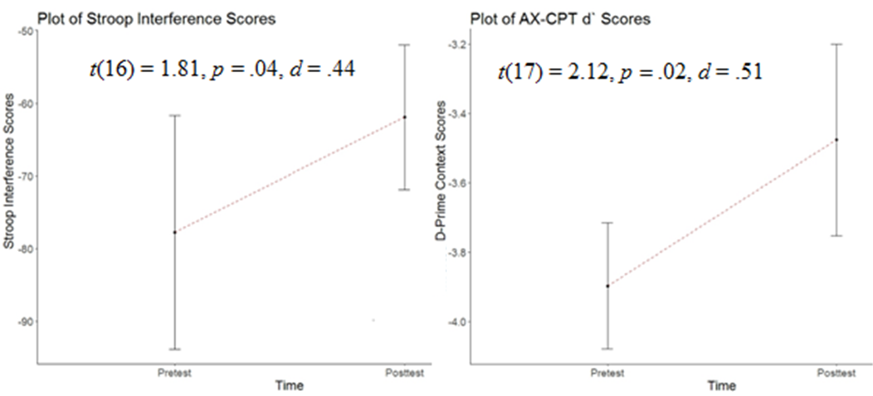
Result 2: Evidence for Near Transfer

Slide 15
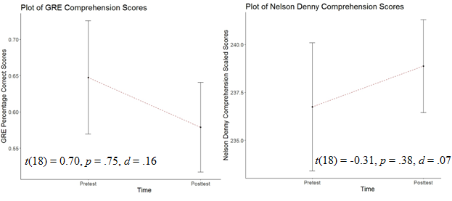
Result 2: No Evidence for Far Transfer

Slide 16
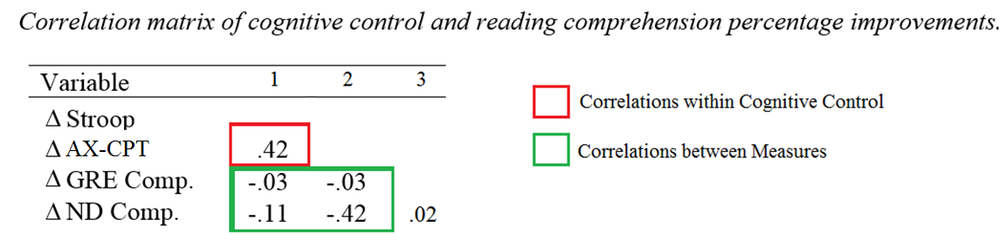
Result 3: Correlation of Improvements
None of the correlations were significant
Possibly due to small sample size (n = 17)

Slide 17
Discussion: Summary of Evidence
Training improved subjects’ WMC
Improvement transferred to cognitive control but not to reading comprehension
Improvements between cognitive control measures are correlated
Evidence of near transfer, but not far transfer
Findings are consistent with meta-analyses
Shipstead, Redick, & Engle, 2012
Melby-Lervåg & Hulme, 2013
Melby-Lervåg, Redick, & Hulme, 2016

Slide 18
Why near transfer but not far transfer?
Cognitive control shares more processes with the training
Is cognitive control important for reading comprehension?
Analysis on baseline data (n = 60)
Cognitive Control and Comprehension: r(59) = .42, p < .01
Notes:
If all the prereqs are there, why no far transfer?
Point 1: one interpretation is…
Point 2: That begs the question, which processes are important for reading comprehension, and if a training focusses more on those processes, will reading comprehension improve?
And what domain specific vs domain general processes

Slide 19
In conclusion
With an improved methodological design and concerns addressed AND
Cognitive control and reading comprehension are correlated
Improvement in cognitive control, but not in reading comp.
Randy Engle: “height and weight are correlated; I’ve gained 20 pounds since grad school but I haven’t grown an inch”
Consistent with meta-analyses; near transfer of training, but not far transfer of training
Future Directions: Examine the efficacy of a Cross-training paradigm
Notes:
Point 1: Perhaps …
Point 2: That begs the question, which processes are important for reading comprehension, and if a training focusses more on those processes, will reading comprehension improve?

Slide 20
Thank you, Questions?
Notes:
Point 1: Perhaps …
Point 2: That begs the question, which processes are important for reading comprehension, and if a training focusses more on those processes, will reading comprehension improve?

Slide 21
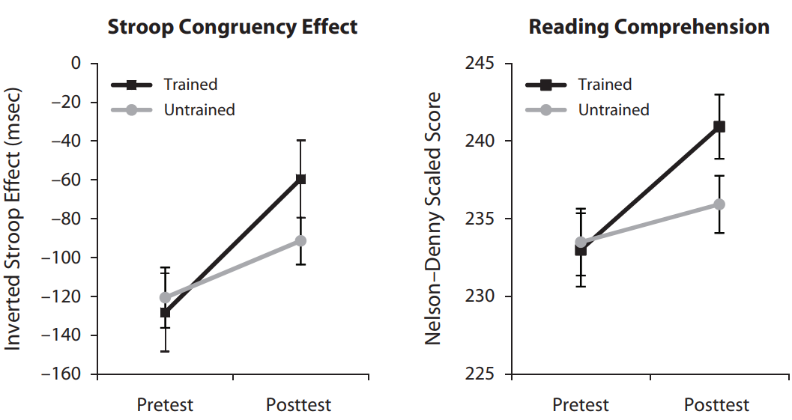
No Control Group Issue
More than 5 weeks between pre and post, other studies…
Size of the practice effect, as seen in the non-active control groups of other studies

Slide 22
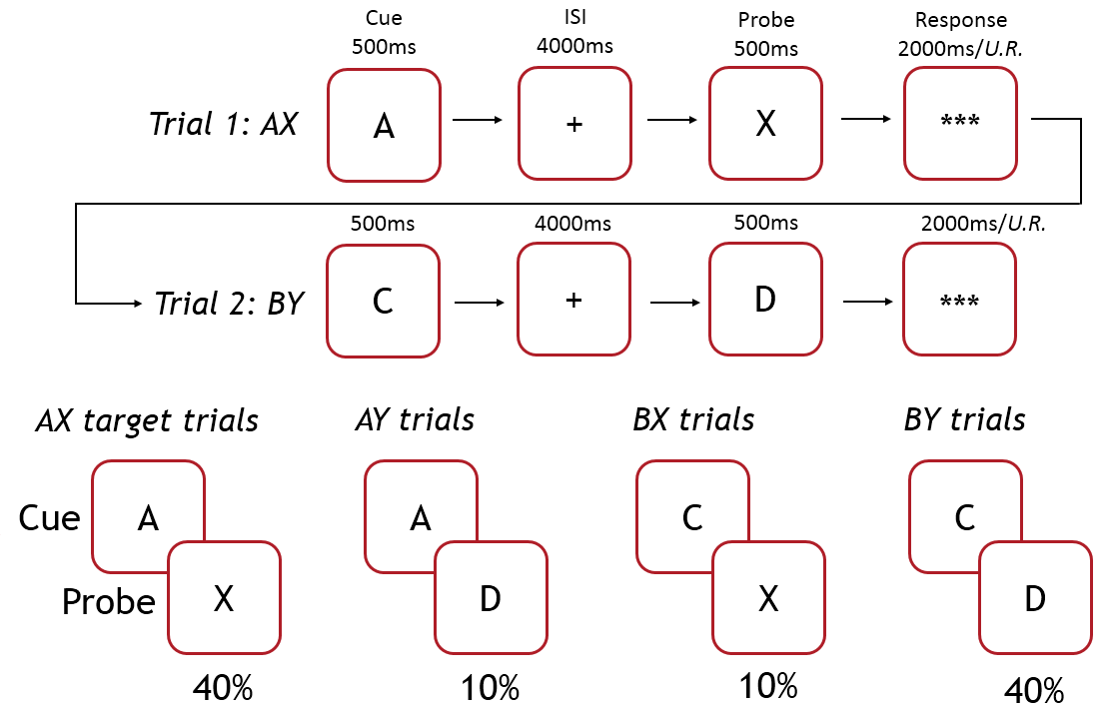
AX-CPT

